Slide 1
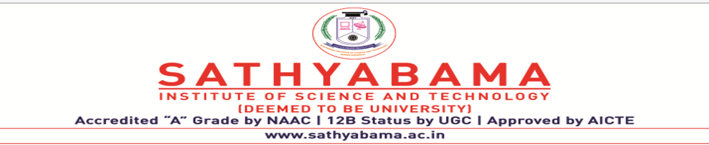
GRADE CALCULATION USING ROBOTIC PROCESS AUTOMATION (RPA)
PROJECT SUPERVISOR:- DR.HEMALATHA MAM
Submitted by – ATLA RANADHEERAJ
Register no. - 38110057

Slide 2
COURSE CERTIFICATE
.

Slide 3
INTRODUCTION
• Calculation of grades for students has become a task for a large group of students to avoid this RPA used.
• Robotic Process Automation (RPA) is a type of automation technology currently transforming the way businesses operate.
Excel automation streamlines your use of the application by automatically performing tasks.
• Teachers today must make better and faster decisions than ever. Investments which are focusing on information technology are often considered as a critical method of speeding up and improving the management decision making. Yet it has proved distressingly difficult to understand the actual potential of investments in Information Technology. This is particularly common in Teaching areas focusing on Human Resource

Slide 4
.
In almost every Educational organization, the responsibility of performing various strategic tasks such as management of the grade evaluation process, lies within the Human resource department.
However, every organization are now looking for more advanced methods of automation, which may help them to manage various complex processes such as, Data storage, Data control and modifications, Effective communication process enhancement, better connectivity with all departments easily and swiftly which would also be useful for the long-term goals of the Education organization.
Information Technology has now considered as a potential tool that managers use, both generally, and in human resource functions, to increase the capabilities of the Education organization.

Slide 5
OBJECTIVES
● Gain insights into building blocks of Blue Prism automation.
● Importing MS Excel VBO (Visual Basic for Applications) in Blue Prism.
● Tuning Process Studio with specific needs.
● Working with different stages in the Process studio.
● Build a Grade Calculation Excel Automation that works over Microsoft excel.

Slide 6
PURPOSE
Manage Student grade Information Efficiently.
Generate and Manage the student grade Processes according to the percentage assigned to the Students.
Generate all the grades of the students .
• Manage total Number of students passed.

Slide 7
Features of Proposed System
A sophisticated grade calculation algorithm.
Error prevention
Reporting and statistics
• Calculating the grade of students
• Passed students Calculation
• Send grade slips through mail to parents
• Generate annual pass-fail of students

Slide 8
REQUIREMENTS
Pre-requirements for Blue Prism
• Creates and supports a digital workforce of industrial strength and enterprise
scale.
• Does not require IT skills to implement
• Can be implemented in sprints of 4 to 8 weeks (Start to finish)
• Is very low cost compared to the TCO of alternative solutions
• Provides tremendous payback with self-funding returns and an ROI that has been as high as 80%
• Can be managed within IT infrastructure and processes

Slide 9
Installation of Blue Prism
The following are the installation requirements for Blue Prism –
• Windows 10 (Preferred) OS, 64 bit
• Blue prism installation Software, 64 bit
• Blue Prism License File
• SQL Server Express Edition, 64

Slide 10
Software Requirements
• Operating system: Windows XP/Vista or any main stream OS
• Installation and Setup Guide for Blue Prism
• Installation and Setup Guide for MS Excel
• Blue prism Version: 6.10.1
• Blue prism License File
• Blue prism installation Software 64 bit
• MS Excel
• Windows 7/8/10

Slide 11
Hardware Requirements
• Internet connection to download and activate
• Administration access to install and run Blue Prism
• Minimum 10GB free disk space
• Windows 8.1 or 10.
Minimum System Requirements to run Office Excel 2013, your computer needs to meet the following minimum hardware requirements:
* 500 megahertz (MHz)
* 256 megabytes (MB) RAM
* 1.5 gigabytes (GB) available space
* 1024x768 or higher resolution monitor

Slide 12
Project Flow
● Importing Blue Prism MS Excel VBO (Visual Basic for Applications)
● Binding Process Studio with MS Excel VBO.
● Opening MS Excel Workbook.
● Specifying Blue Prism Stages to work on MS Excel Workbook in Blue Prism.
● Tuning Process Flow with Blue Prism Actions.
● Closing MS Excel Workbook.

Slide 13

FLOW AND IMPLEMENTATION
Idea:
Need to find a new one --“Generally, in the educational management monitoring the machine status continuously and maintaining the records of the entire data plays a very important role as that helps the officials to analyze the grading factors. This also helps in resolving some of the problems like machine failures, production delays, etc.

Slide 14
ACTIVITIES
Milestone 1: Configure the Process Studio
Let us create the Process Object bind with MS Excel VBO.
Object studio is mainly used to develop the objects. Inside the object, we have different types of actions as follows:
1. Application Modular to Spy the Elements
2. Initialize page and clean up page.

Slide 15
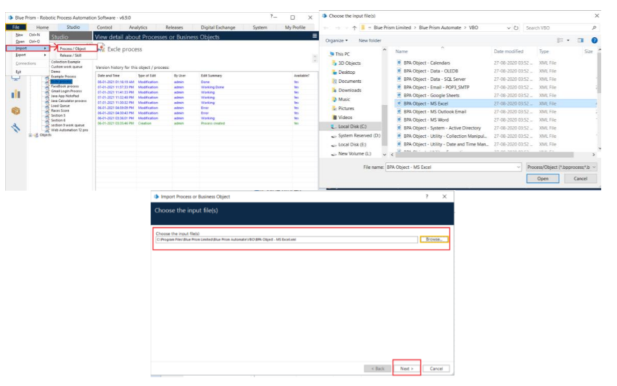
Activity 1: MS Excel VBO (Import VBO file)
File -> Import -> Browse -> (C:\Program Files\Blue Prism Limited\Blue Prism Automate\VBO\BPA Object-MS Excel). Click Finish.

Slide 16
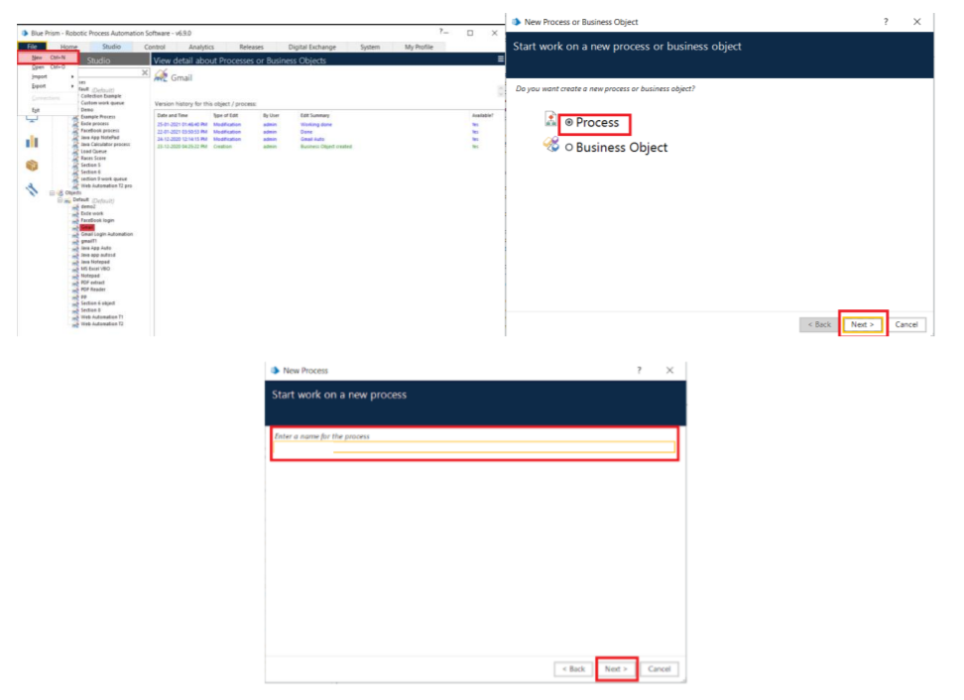
Activity 2: Creating the Process Object from Object Studio
Process studio has only the Main page. We can call from the process studio. We use the Process studio for developing and testing.

Slide 17
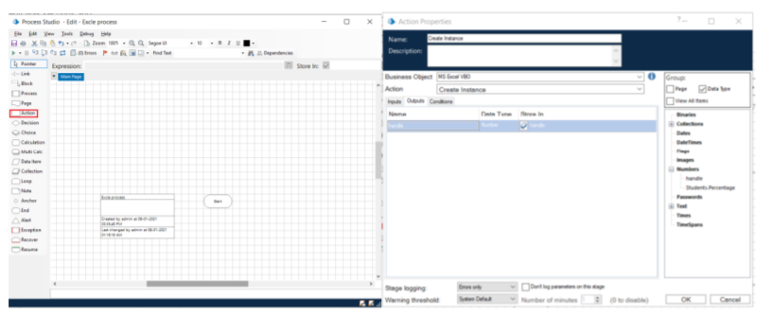
Grade Calculation Excel Automation

Slide 18
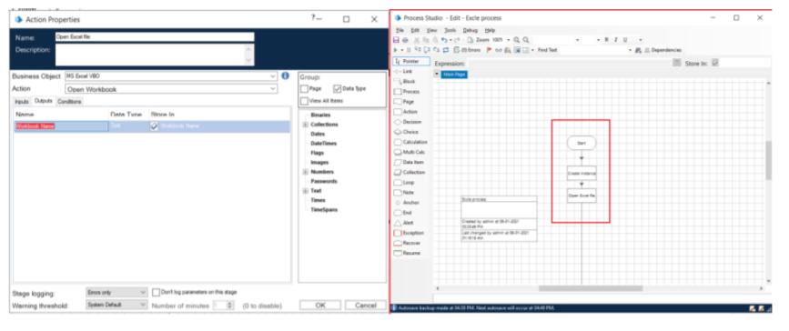
1. Create Action Stage as “Create Instance” (Business Object = MS Excel VBO; Action = Create Instance).
a. Click on the Outputs tab
I. Create Data Item, type = number, name = “handle”. Drag it into the store in column.
II. Click on ok.

Slide 19
2. Create Action Stage as “Open Excel file” (Business Object = MS Excel VBO; Action = Open Workbook).
a. Click on the Inputs tab
i. Drag “handle” data item into handle Value column.
ii. Set file path of excel file in File Name Value column

Slide 20
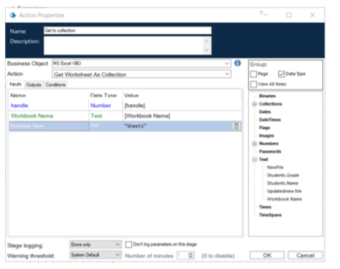
3. Create Action as “Get to collection” (Business Object = MS Excel VBO; Action = Get Workbook As Collection).
a. Click on the Inputs tab
i. Drag “handle” data item into handle Value column.
ii. Drag “Workbook Name” data item into the Workbook Name Value column
iii. Write Worksheet name as “Sheet1”.

Slide 21
4.Drag Loop module, Drag Choice module. Connect loop start with choice start.
Open Choice Properties and create the following fields.
a. [Student .Percentage]>=70 AND [Students .Percentage]<=79
b. [Student .Percentage]>=80 AND [Students .Percentage]<=89
c. [Student .Percentage]>=90 AND [Students .Percentage]<=100

Slide 22
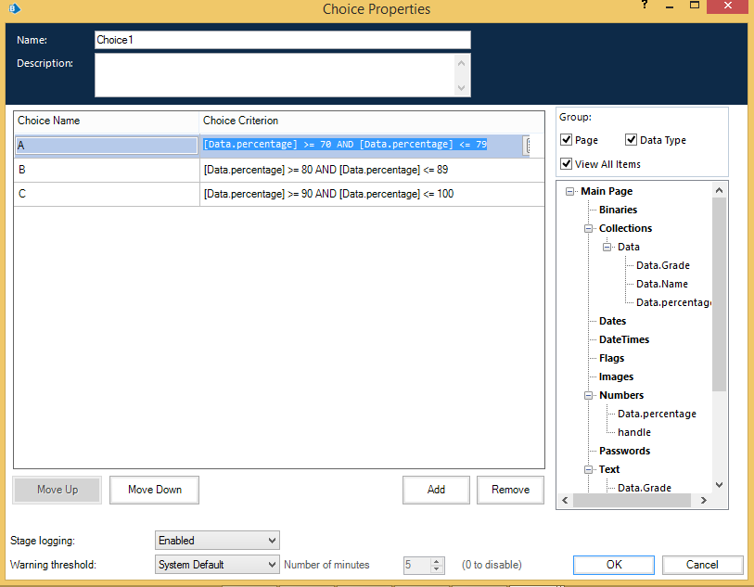

Slide 23
5. Create Action Stage as “Write collection” (Business Object = MS Excel VBO; Action = Write Collection).
a. Click on the Inputs tab
i. Drag “handle” data item into handle Value column.
ii. Drag “Workbook Name” data item into the Workbook Name Value
column.
iii. Drag “Employee” Collection into the Collection Value column.
iv. Write Worksheet name as “Sheet1”.
v. Write Cell Reference as “A1”.
vi. Set Include Column Names as True

Slide 24
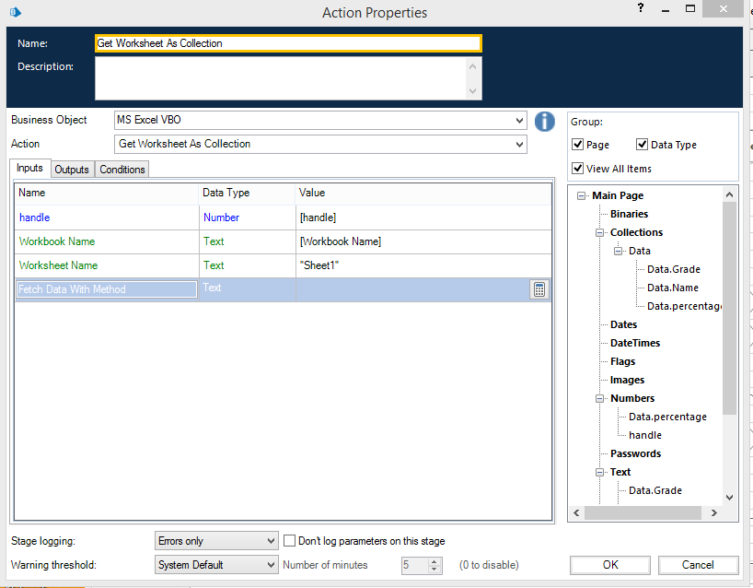

Slide 25
6. Create Action Stage as “Save Excel file” (Business Object = MS Excel VBO; Action = Save Workbook).
a. Click on the Inputs tab.
i. Drag “handle” data item into handle Value column.
ii. Drag “Workbook Name” data item into the Workbook Name Value column.
7. Create Action Stage as “Close workbook” (Business Object = MS Excel VBO; Action = Close Current Workbook).
a. Click on the Inputs tab
b. Drag “handle” data item into handle Value column
c. Do connections as follows.

Slide 26
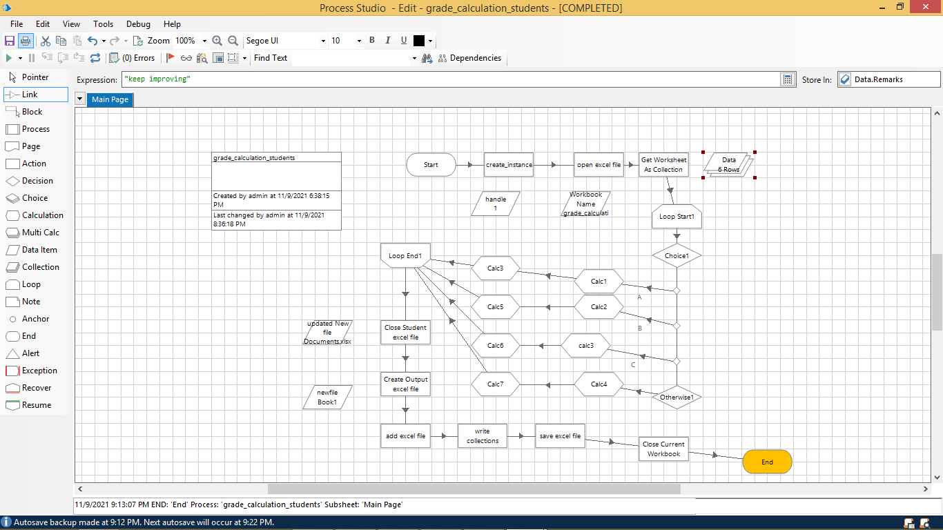

Slide 27
Activity 3: Testing the Process Object from Object Studio
Click on the Main Page, click on the Green play button to run the ‘Excel Process’ Process object. It shows COMPLETED when there is no error or no failure in the object.
Click on the Main Page, click on the Reset button to reset the cache for rerun the process object as fresh.

Slide 28
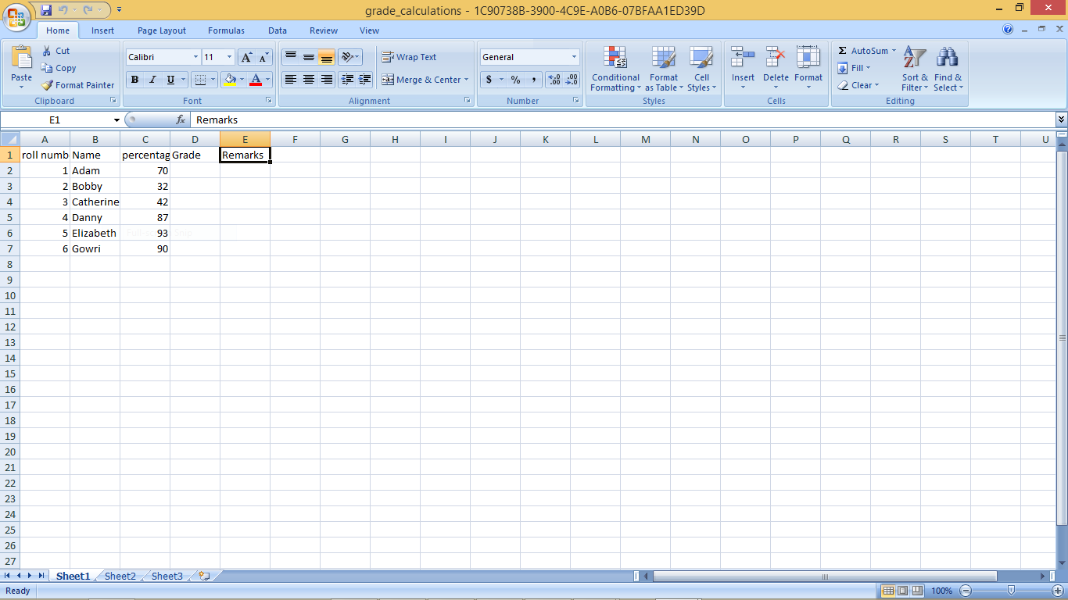
Input Excel file

Slide 29
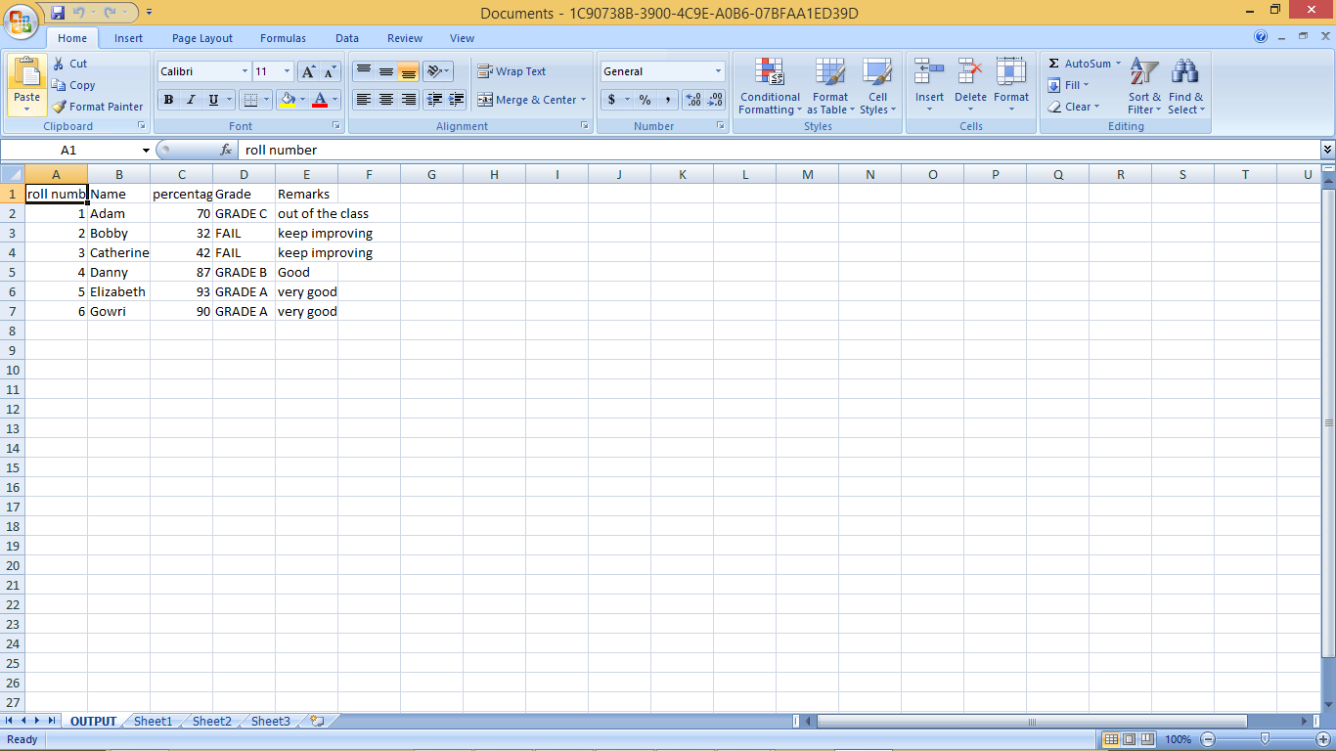
output

Slide 30
CONCLUSION
From an student grade and feedback has been identified as a key component of students success .To promote effective learning, students need to be given multiple real world exercises and need to receive rapid and meaningful feedback and remarks .With an increase in class sizes and the time involved in manually grading assignments , instructors have adapted methods that do not promote student learning.

Slide 31
FUTURE ENHANCEMENTS
One impact on grades which is planned for a future
study is the use of pre-grading. As noted earlier, over 33% of
instructors offered pre-grading on assignments. This
permitted students to submit their projects early. The projects
are then re-graded and comments posted to assist the
students. The students could resubmit by the due date for an
updated grade. Future plans include measuring the impact of
students who take advantage of pre-grading versus those
who don’t on future projects and tests in the class

Slide 32
BIBLIOGRAPHY AND REFERENCES
Ahonjemi, T. and Karavirta, V. (2009). Analyzing the use of
a rubric-based grading tool. Proceedings of the fourteenth
annual ACM SIGCSE Conference on Innovation and
technology in Computer Science Education, 333–337.
Anglin , L., Anglin K., Schumman, P., and Kalinski, J.,
(2008). Improving the efficiency and effectivement of
grading through the use of computer assisted grading
rubrics. Decision Sciences Journal of Innovative
Education, 6 (1), 51-73 .
Conole , G. and Warburton, B. (2005). A review of
computer-assisted assessment. Research in Learning
technology, 13(1), 17–31.
Kevin Matthews , Thomas Janicki , Ling He. Laurie Patterson. Implementation of an Automated Grading System with an Adaptive Learning Component to Affect Student Feedback and Response Time

